Slide 1
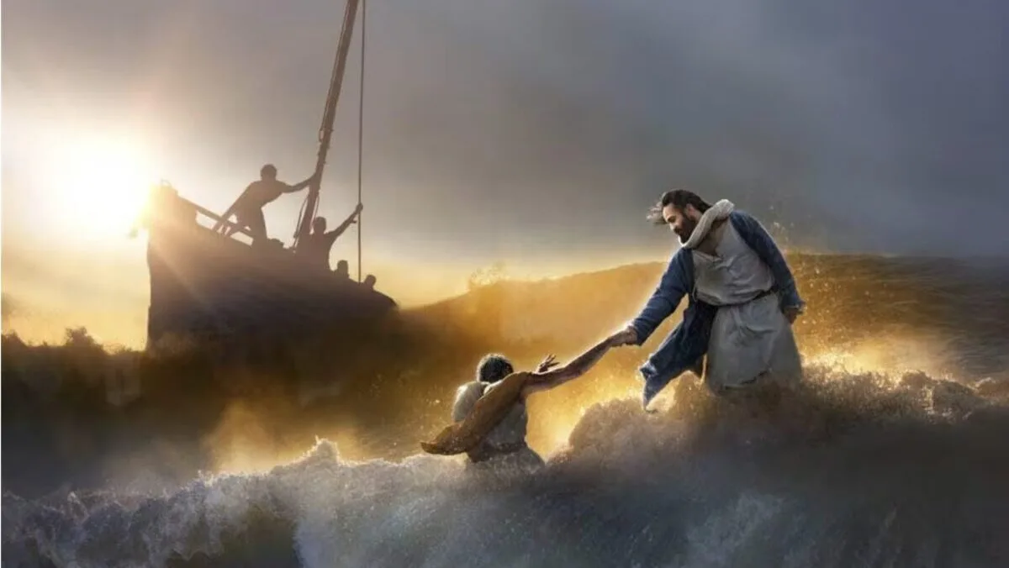
Matthew 14: 22-33
Notes:
Matthew 14:22-33 this is a reading that holds a lot of meaning for me personally. While Peter actively stepped out of the boat when Jesus called to him, when I started on the discernment journey it felt very much like I had slept walked out of the boat and found myself in a raging sea. But that is not what I am focusing on today.

Slide 2
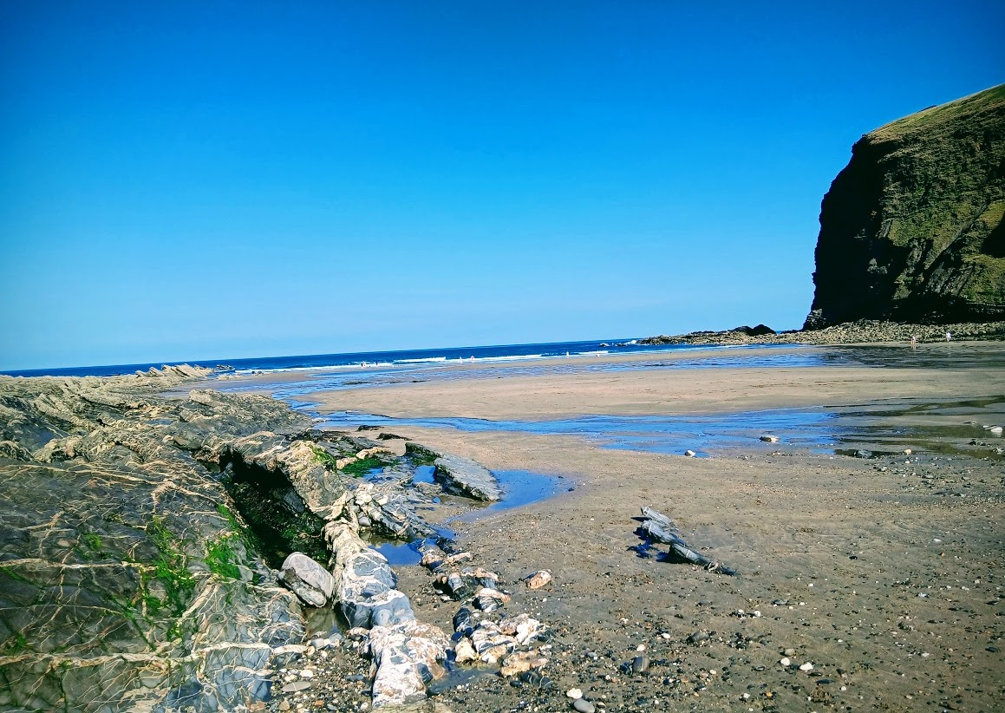
15 words
starting with P
that relate to this morning’s gospel!
Profound: Deep spiritual truths revealed.
Perilous: Dangerous, life-threatening sea storm.
Petrified: Disciples terrified by the waves.
Phantom: Mistaking Jesus for a ghost.
Power: Christ treading over nature.
Presence: Divine comfort in chaos.
Proclamation: "Truly, you are the Son of God.“
Peter: Key human figure walking.
Plunging: Sinking down into water.
Petition: "Lord, save me!" cried.
Preservation: Immediate rescue from drowning.
Puzzled: Mark notes their confusion.
Praise: Falling down to worship.
Phony: Peter's temporary, failing faith.
Preeminent: Jesus proving His absolute supremacy.
Environment - Creation
Human Response – Disciples Reactions
Divine Revelation - Jesus
Notes:
These words can be put into 3 groups

Slide 3
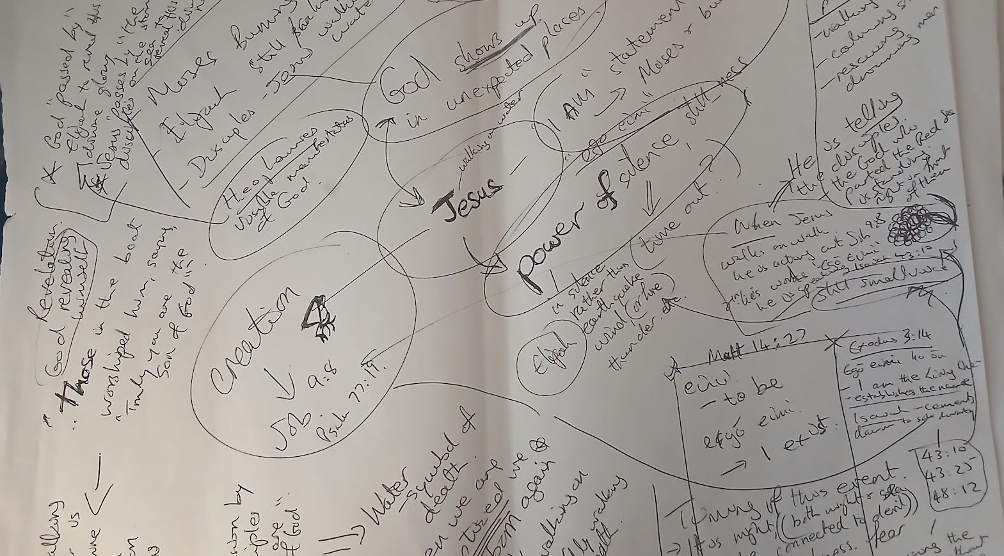
Power in silence, stillness
egō eimi
I AM
Disciples
Peter
Jesus
Elijah
Walking on water
Wind
Thunder
Earthquake
Fire
Power over creation
God passed by
God revealing himself in unexpected places and ways

Slide 4

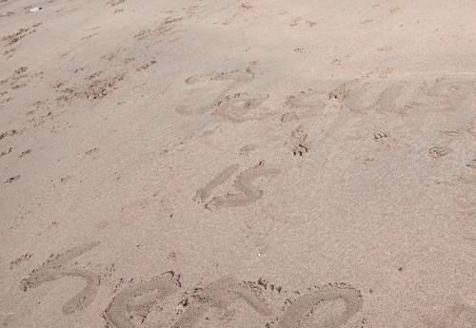
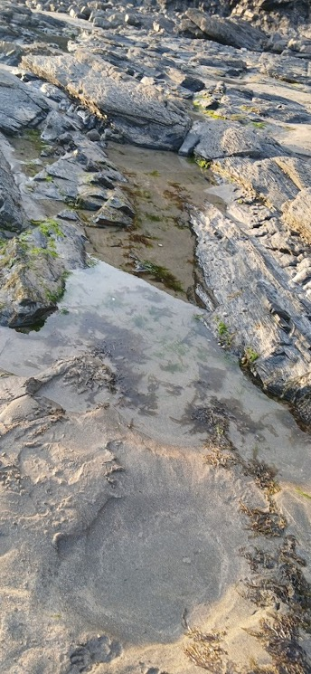
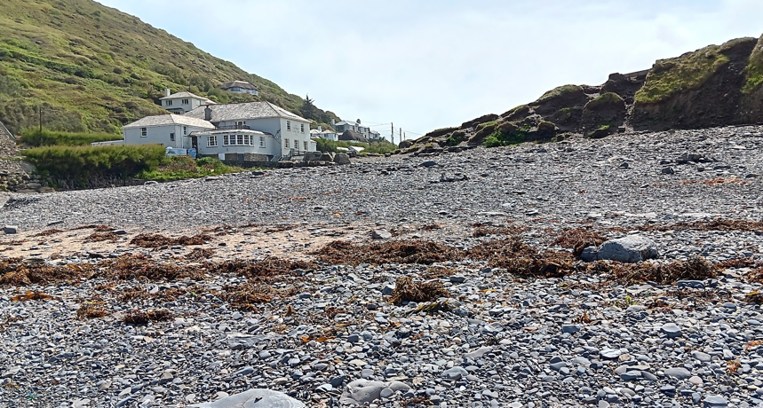
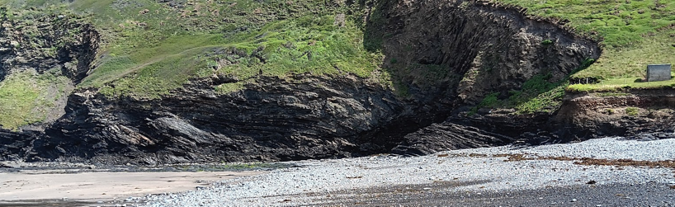
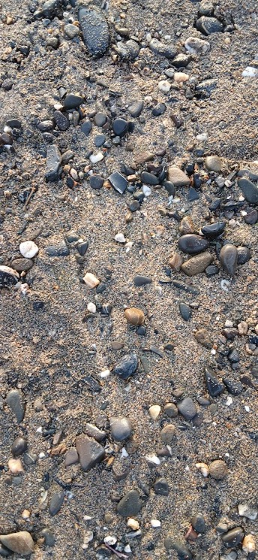
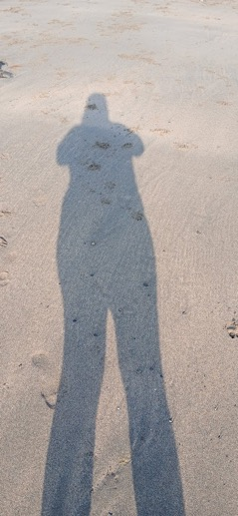
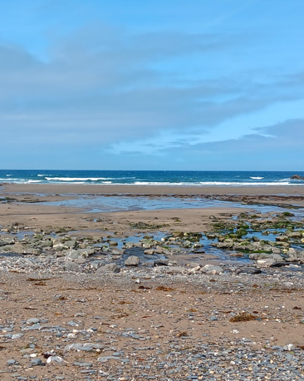
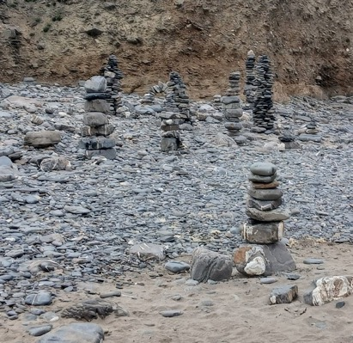
A version of what we have heard from Matthew appears in 3 out of the 4 gospels
Notes:
This story of Jesus walking on water is recorded in three out of the four gospels. Anybody know which one it doesn’t appear in? Where it does appear, there are subtle differences in how the event is recorded. I say subtle, actually they are quite striking. When we look at or listen to things from different angles or perspectives we build a clearer picture of what we are actually looking at.

Slide 5
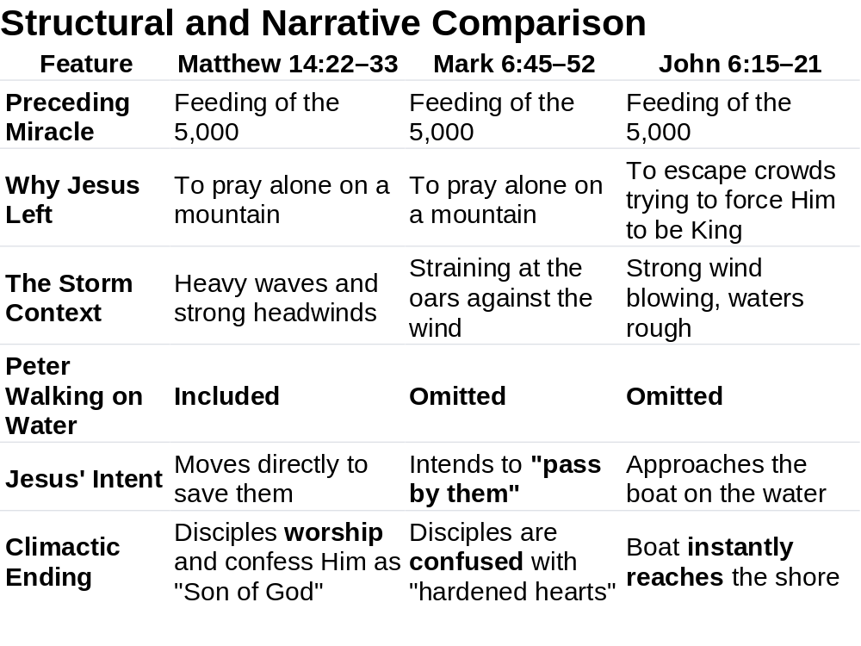
Disciples
Sea
Boat
Later on in Matthew –
Jesus says Peter is the rock
on which he will build his church
Learning to keep eyes
on Jesus while in a storm

Slide 6
Walking on Water
Link back to Job (9:8)
He alone stretches out the heavens
and treads on the waves of the sea.
And Psalm 77:19
Your path led through the sea,
your way through the mighty waters,
though your footprints were not seen.
Isaiah 43:2
When you pass through the waters,
I will be with you;
and when you pass through the rivers,
they will not sweep over you…
Notes:
The disciples should have known or understood the meaning of Jesus walking on water. He was demonstrating his power over creation. Water a symbol of death, and here was Jesus walking over it. But instead of understanding, the disciples are scared, they think they are seeing a ghost, so Jesus calls out to them … There have been moments in my life when I know that I have seen or heard things which can only have been from God. Moments which I still do not understand the meaning of fully. A night in Dublin, sleeping on a sofa at a friend’s house, and I woke up to find a white figure stood over me. I thought it was a ghost but at the same time I knew it wasn’t. A hand touching me on the shoulder and saying it’s ok go back to sleep, there’s nothing to fear.

Slide 7
Not qualified
I am the Bread of Life
I am the Vine
I am the… (as in John 6)
egō eimi
I AM
But simply
I AM or it is I
The Hebrew verb ehyeh means "I am" or "I will be"

Slide 8
Peter’s challenge
IF it is you - command me to come to you
walking on the water
Peter steps out of the boat and almost
immediately starts to sink
Notes:
Peter in true Peter fashion – questions, his response to Jesus saying it’s alright it is I, is IF it is you – command me to come to you walking on the waters. And Jesus says ok then COME. Peter steps out of the boat, and starts walking on water, and then starts to sink as he realises what he is doing. He takes his eyes off Jesus and looks around at the storm, and the water and it all becomes a bit too real and daunting. But Jesus doesn’t stop there, his hand is out ready to pluck Peter from water and to place him back in the boat with the other disciples.

Slide 9
Mean while back in the boat
Notes:
I can’t help wondering what the disciples in the boat were doing while this was all going on. What was their reaction to Peter jumping out of the boat and trying to walk on water.
When Jesus returns himself and Peter to the boat, the storm ceases, and the disciples (at least in Matthew’s version) understand completely who Jesus is and we have their First communal acknowledgement.

Slide 10
What does this all mean for us here in Boscastle?

