Slide 1
Creation Sunday

Slide 2
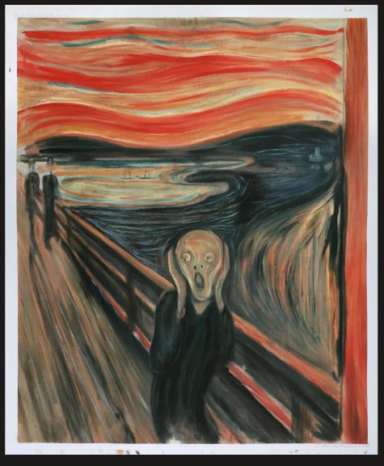
“Truly I tell you,” he continued, “no prophet is accepted in his hometown”.(Luke 4:24 )

Slide 3
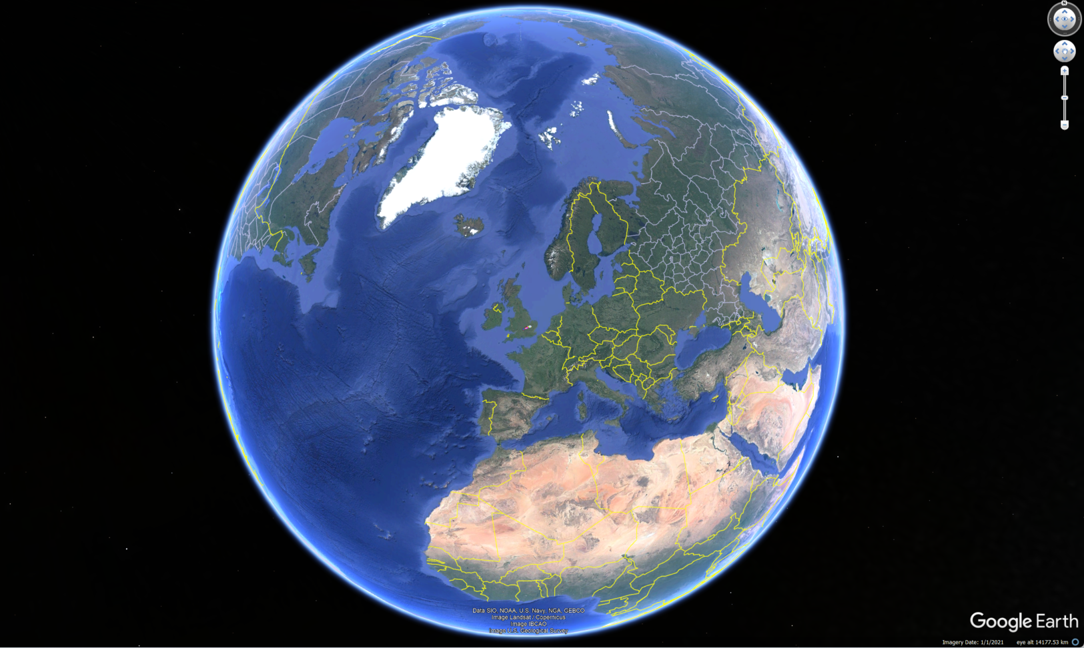

Slide 4
1 In the beginning was the Word, and the Word was with God, and the Word was God.
² He was with God in the beginning.
³ Through him all things were made; without him nothing was made that has been made.
⁴ In him was life, and that life was the light of all mankind.
⁵ The light shines in the darkness, and the darkness has not overcome it.

Slide 5
 | Genesis 1 | John 1
v1 | In the beginning…God | In the beginning…Word…God
v2 | The Spirit (of God) moved across the water | He (the Word) was there with God
v3 | Let there be light (made) | All things were made by him
V4 | The light was good | In him was life, and the life was the light of men.
V5 | Light/dark…the first day | The light shines…it has been overcome

Slide 6
¹⁷ “Do not think that I have come to abolish the Law or the Prophets; I have not come to abolish them but to fulfill them”.
³⁷ Jesus replied: “‘Love the Lord your God with all your heart and with all your soul and with all your mind.’^{[c]} ³⁸ This is the first and greatest commandment. ³⁹ And the second is like it: ‘Love your neighbour as yourself.’ ⁴⁰ All the Law and the Prophets hang on these two commandments.”
Matthew’s gospel

Slide 7
Loving the world and God’s creation must sit squarely within those 2 commands.
How can we love God and abuse his creation?
How can we love our neighbour and destroy the planet?

Slide 8
“A man was going down from Jerusalem to Jericho, when he was attacked by robbers. They stripped him of his clothes, beat him and went away, leaving him half dead. ³¹ A priest happened to be going down the same road, and when he saw the man, he passed by on the other side. ³² So too, a Levite, when he came to the place and saw him, passed by on the other side…then for a long time no-one came…...
The sun beat down by day, the night was very cold…….
…..and the man died…

Slide 9
The Good Samaritan story requires a response from us:
How often do we leave it for someone else… ?
How often do we leave it for another day… ?
So too then with the problems about God’s Creation…
Are we leaving it for someone else… ?
Are we leaving it for another day… ?

Slide 10
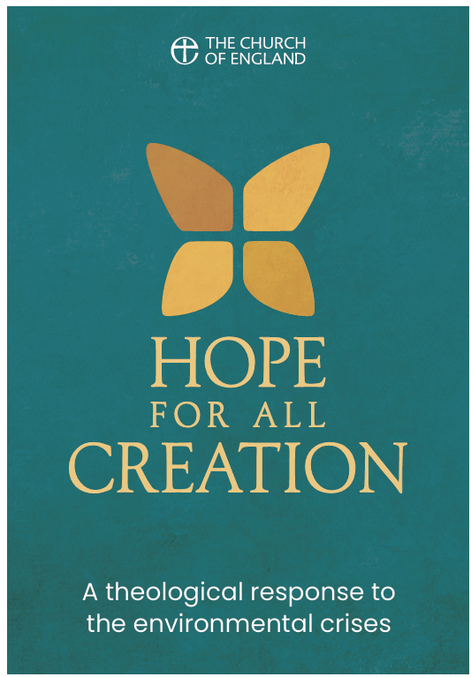

Slide 11
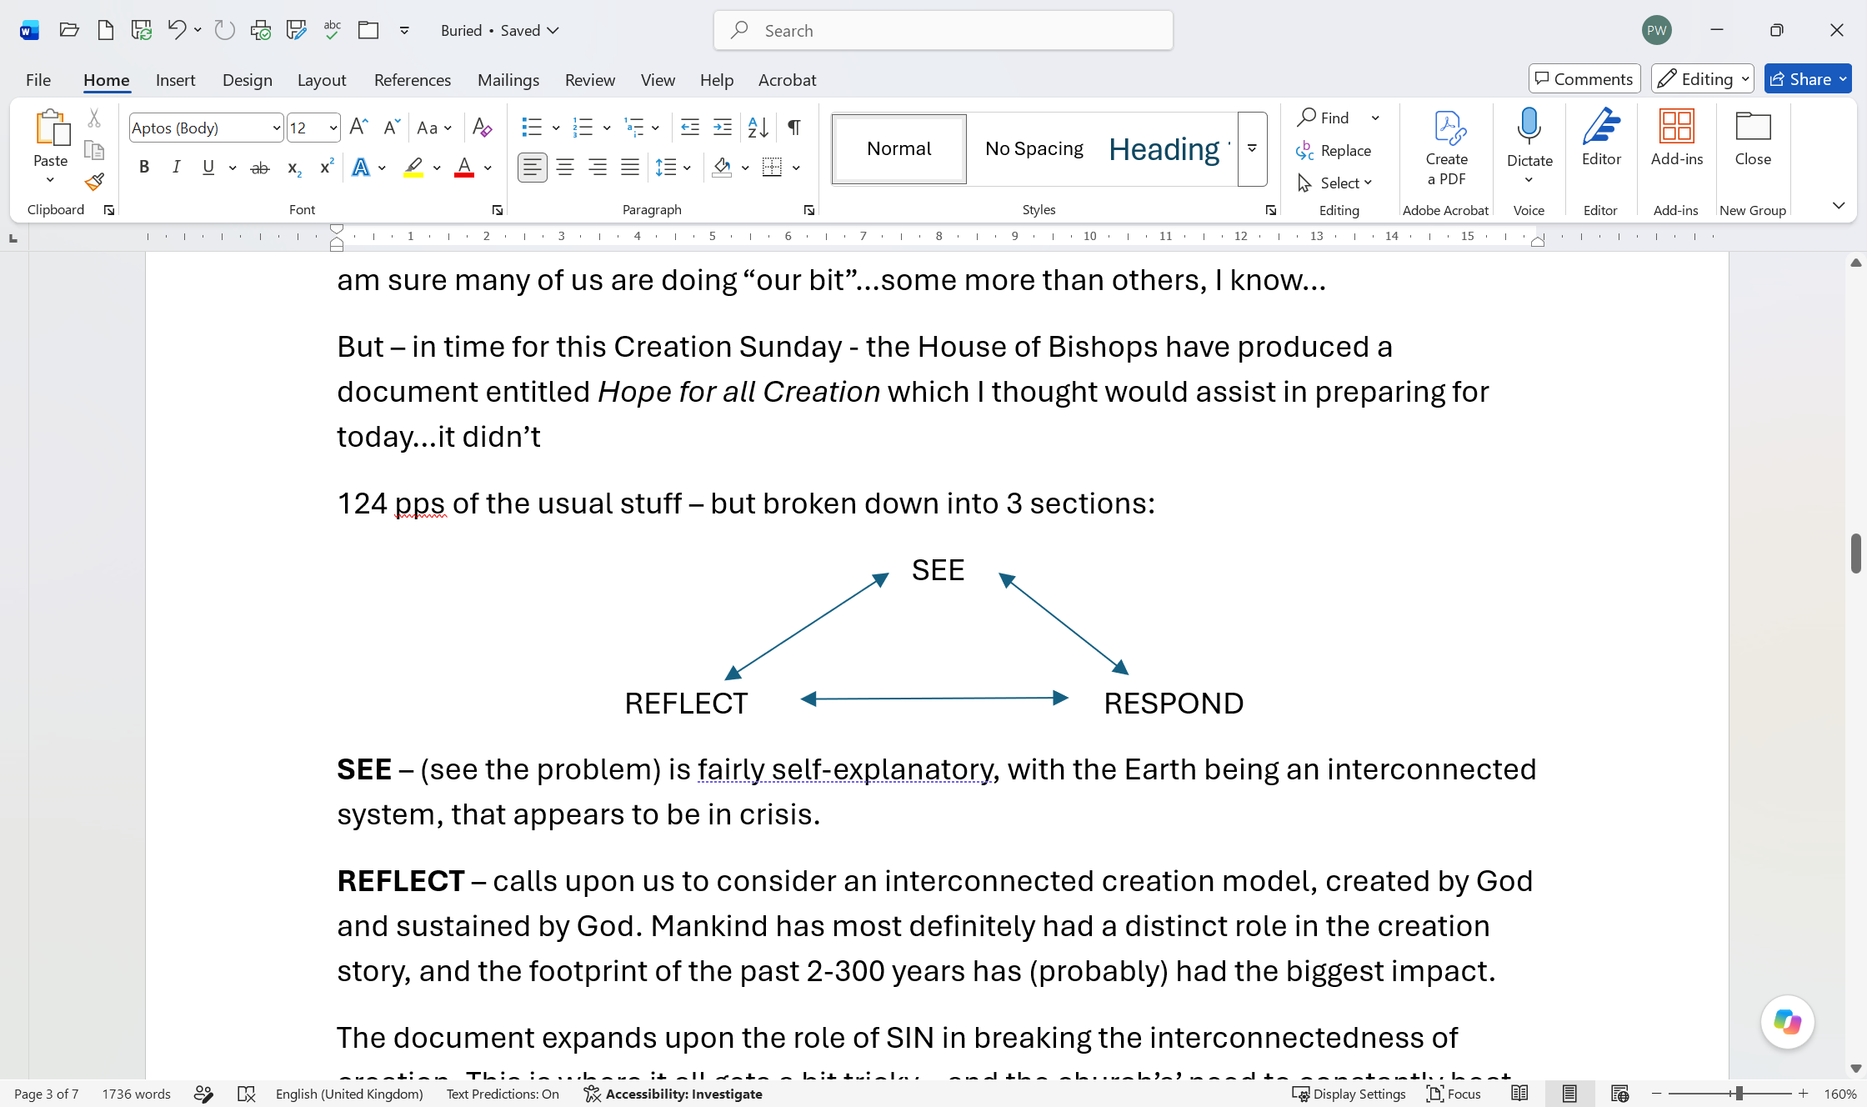

Slide 12
The dictionary has REPENTANCE as
“to be grieved over one's past and seek forgiveness; feel such regret for sins, crimes, or omissions as produces amendment of life…

Slide 13
“…devoted themselves to the apostles’ teaching and fellowship, to the breaking of bread and the prayers …”.
Acts 2:42

Slide 14
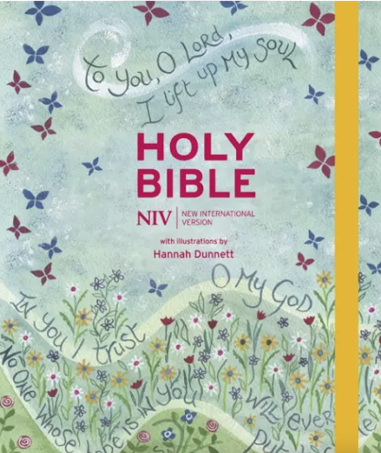
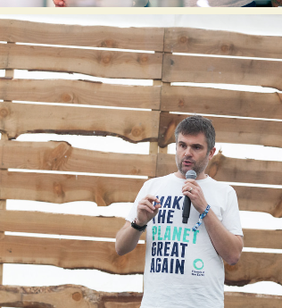
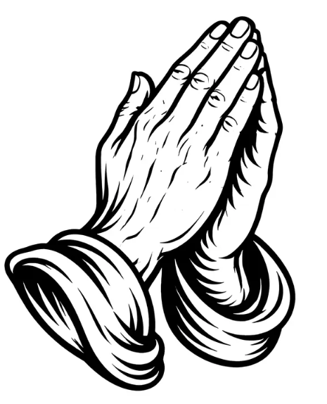
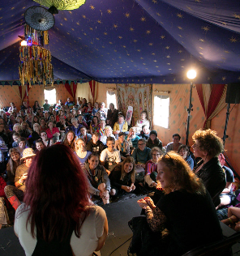
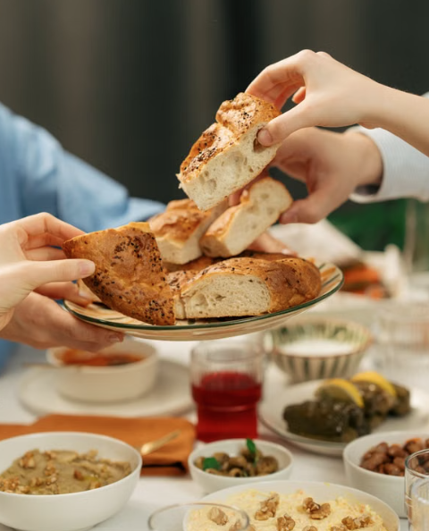
Amen

