Slide 1
What is Worship?
Where do we Worship?
Why do we Worship?
Any ideas?
When do we Worship?
How do we Worship?
Notes:
What is Worship?
Where do we Worship?
When do we Worship?
How do we Worship?
Why do we Worship?

Slide 2
Matthew Burdette (In Christianity Today)
…We worship God because that is why we exist. We care about the poor and about racial reconciliation and justice as acts of worship on our way to the greatest act of worship with all God’s people. That our communion with God in worship should result in bearing fruit of good works is God’s doing alone (Eph. 2:10; Phil. 2:13), …

Slide 3
How many times is Worship mentioned in the Bible?
Simple answer – Lots
Word matches – between 108-188 times
Words carrying the core meaning of worship – THOUSANDS!

Slide 4
3 Hebrew Words
Shachah (שָׁחָה): To bow down, prostrate oneself, or fall flat on the face.
Abad (עָבַד): To serve, work, or labor.
Yare (יָרֵא): To fear, revere, or stand in awe.
Old Testament
Genesis (22:5) – Ultimate Surrender
Exodus (20:3-5) – God’s Commandments
Psalms – Israel’s worship hymnal
New Testament
Gospels – In Spirit and Truth
Epistles - Lifestyle
Revelation – Eternal future of worship
3 Greek Words
Proskuneo (προσκυνέω): To kiss the hand toward, bow down, or prostrate oneself.
Latreuo (λατρεύω): To serve, minister, or render religious service.
Sebomai (σέβομαι): To revere, hold in awe, or feel devout godliness.

Slide 5
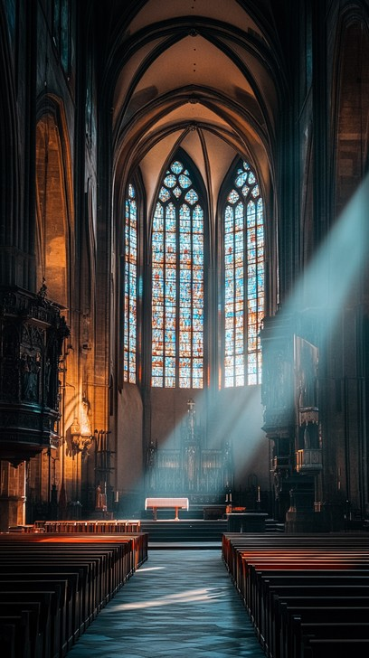
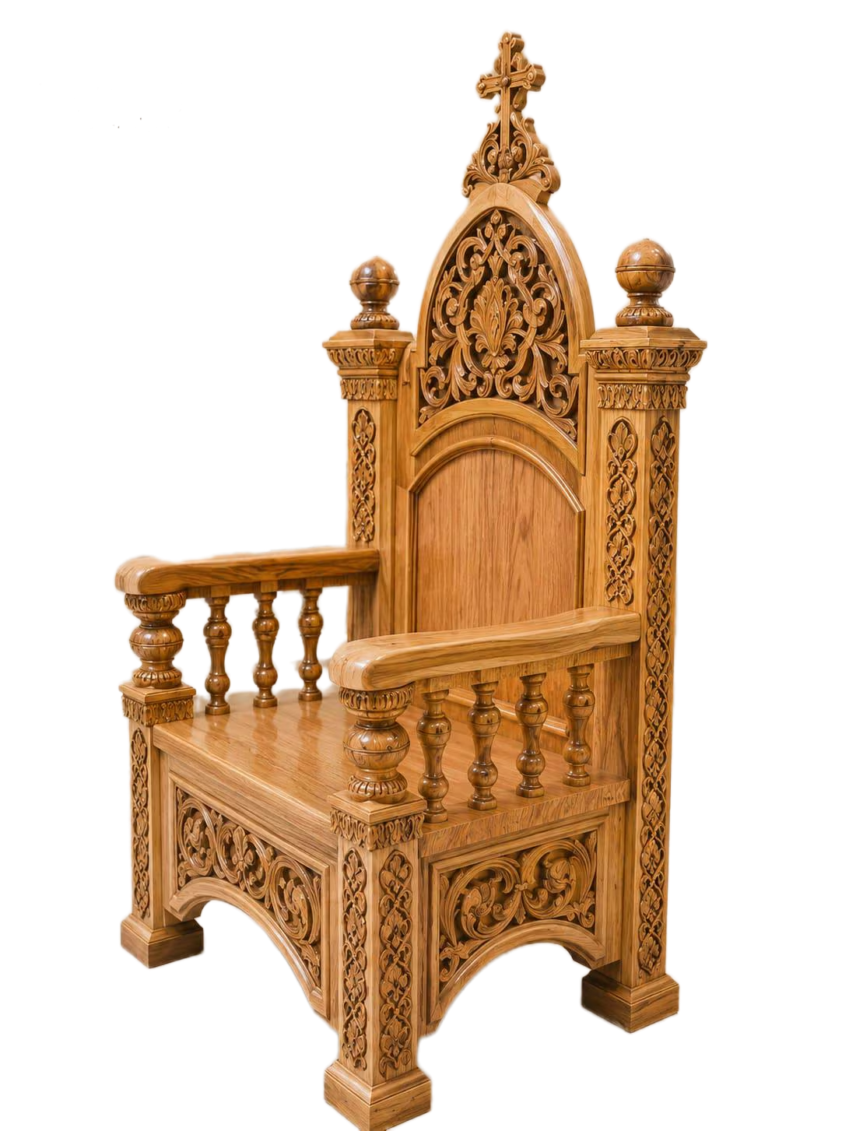
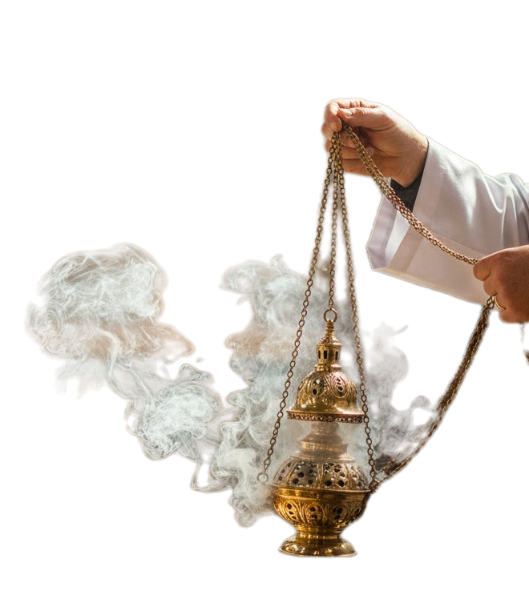
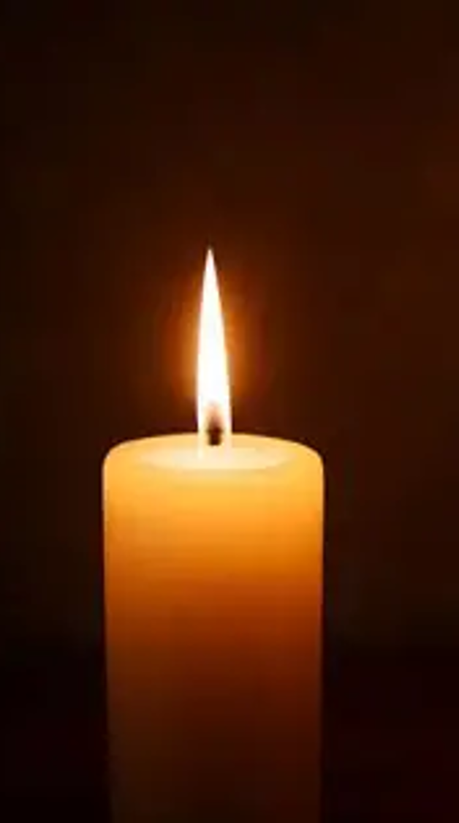
Notes:
Thomas sat cross legged on the cold stone flour of the very large, very grand church which smelt intensely of burning incense with under notes of damp, old beeswax candles, and expensive floor polish. He gazed intently up at the rafters amazed and awestruck by the shear height of the roof and pure magnitude of the building, strange stone figures stared back at him. Sitting on a grand chair that looked like an oversized particularly uncomfortable throne was Revd. Barnaby Bluster, the rector, a man of immense religious proportions, wearing a suit so perfectly pressed it could cut bread, and grand minister's vestments—a flowing robe of heavy silk and a golden sash that made him look like a very holy, very expensive mattress. His voice, when he spoke, sounded like a tuba blowing through a bucket of gravy.
"Listen closely, boys!" Revd. Bluster boomed, glaring down at little Thomas. "This is proper worship. Observe the towering beeswax candles! Notice how the holy smoke billows toward the ceiling! Look at those flashing modern screens behind me displaying the lyrics and admire the majestic shimmer of my vestments as I sing!"
Revd. Bluster puffed out his chest, his waistcoat buttons straining like tiny, terrified prisoners under his silken robes and roared a verse of an ancient melody, abruptly shifting to a booming chorus of contemporary worship music, there was a crash as a startled Dorothy dropped the tray of cups she was carrying, and the battered copper kettle let out a furious, cheerful whistle that mingled with Revd Bluster’s high notes.

Slide 6
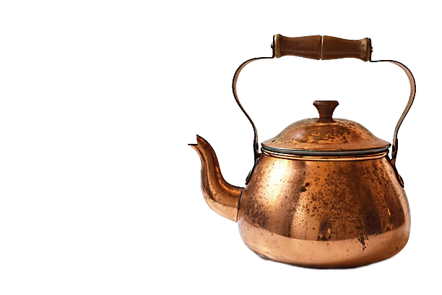
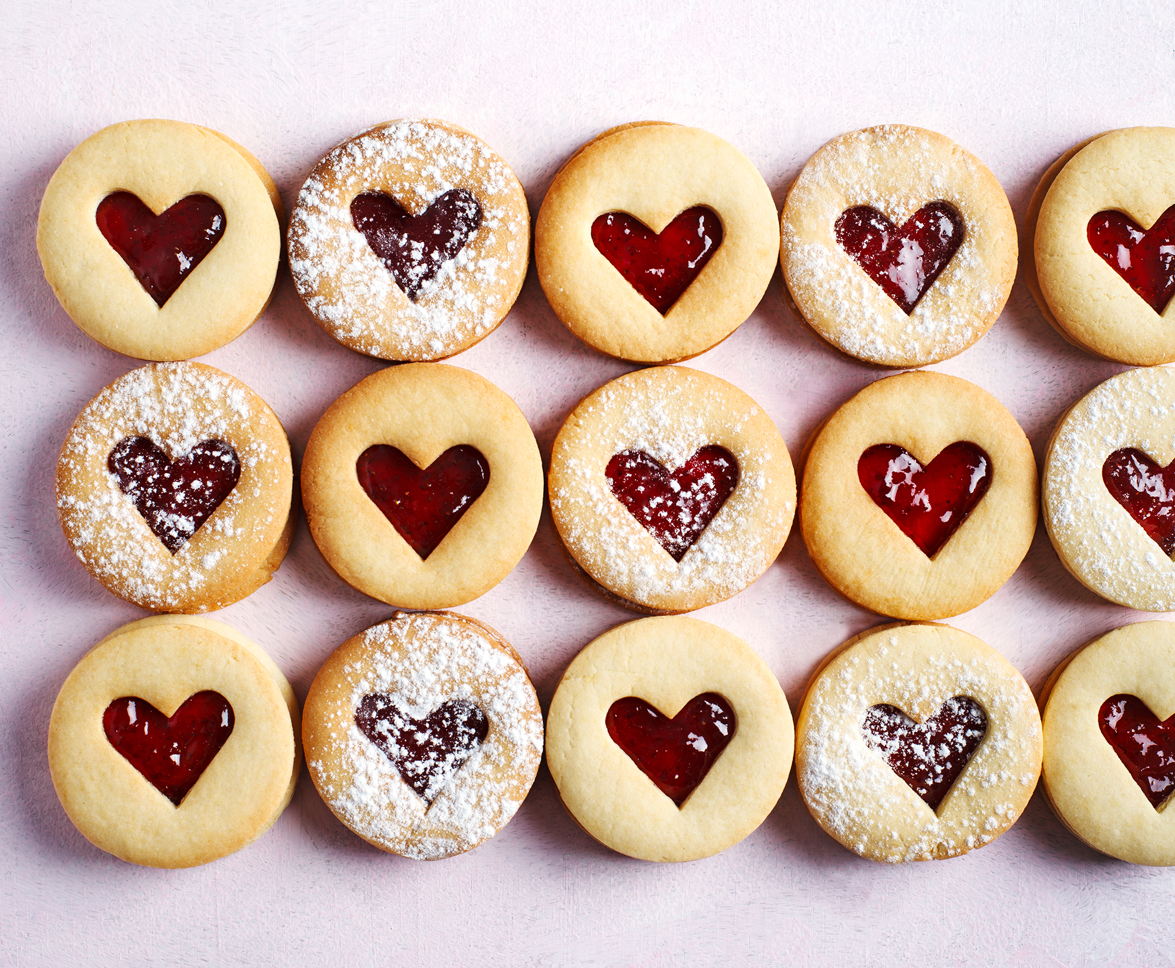
Notes:
Over by the counter, Mr Henderson, the weary but dedicated churchwarden had arrived carrying a massive stack of logbooks and ring-binders. He chatted quietly with Sybil about the upcoming quinquennial inspection and the state of the ancient stonework, high roofs, and hidden rafters, as she layed out neat rows of chocolate biscuits. The groups quiet, welcoming hospitality humming along like a steady engine.
Mabel and Brenda trimmed stems and filled vases with bright, fragrant lilies. They didn't come to the Sunday church services or any services really themselves; they simply loved to make the place look beautiful for everyone else.

Slide 7
THE SCOREBOARD OF RELIGION
Revd. Bluster’s Performance:
• The loudest hymns 🎶
• The thickest incense smoke 💨
• The finest vestments 🥋
Score: 99/100
Notes:
"That," Revd Bluster said, looking highly pleased with himself from his towering perch, and pointedly ignoring the whistle of the kettle, "is worth at least ninety-nine points out of a hundred. God is undoubtedly very impressed with my multimedia production and my wardrobe."
"But Revd Bluster," Thomas squeaked, scratching his ear, "is that what it’s really about? Just making a giant racket, lighting things, flashy modern screens, wearing fancy dress clothes, and looking important?"
Revd Bluster’s face turned the colour of a ripe tomato. "Of course it is, you silly boy! Worship is a performance! It’s about being seen in the right box, wearing the finest ceremonial gear, blasting the trendiest worship music, singing the loudest hymns, and making sure your incense creates the thickest cloud!"

Slide 8

Notes:
Just then, the heavy oak doors burst open with a sudden, joyous rush of cold sea air. In marched the retired priest, Father Timothy, leading a lively, wind-swept group of the congregation. They had all just returned from a week-long beach mission for children and young adults. Father Timothy’s old woollen jumper dusted with sand, and his eyes twinkled behind his spectacles. Behind him, the glowing volunteers carried bright plastic buckets, rolled-up banners, and beach mats, their faces sunburnt and laughing as they began kicking off their sandy trainers by the door.
The ladies in the kitchen instantly cheered. Mrs Higgins in her floral apron and warm smile lifted the kettle pouring boiling water into a dozen giant teapots to welcome the exhausted beach team while her helpers fetched plates of chocolate biscuits and sausage rolls.
Behind the chaotic arrival shuffled old Mr. Twigg, the church caretaker. Mr. Twigg was a tiny man who looked as though he had been gently dried in the sun like a raisin. His boots were covered in mud, and his coat was patched with bits of an old potato sack—lightyears away from Revd. Bluster's splendid garments.
He didn't notice the flickering candles, the dazzling animations on the modern screens, the grand show, or even the lively commotion of the beach mission team setting down their buckets in the back. Walking straight past Revd Bluster's majestic seat he knelt at the altar, leaning gently on the rail and closed his eyes.
He didn’t shout. He didn't check to see if anyone was watching. In fact, he didn't say anything at all for a long time. He just knelt there, breathing softly beneath the swirling smoke, while the distant rumble of the boiling kettle, the low murmurs of the women making tea, and the sandy laughter of the youth team drifted through the building. A look of pure and quiet wonder washed over his face.

Slide 9
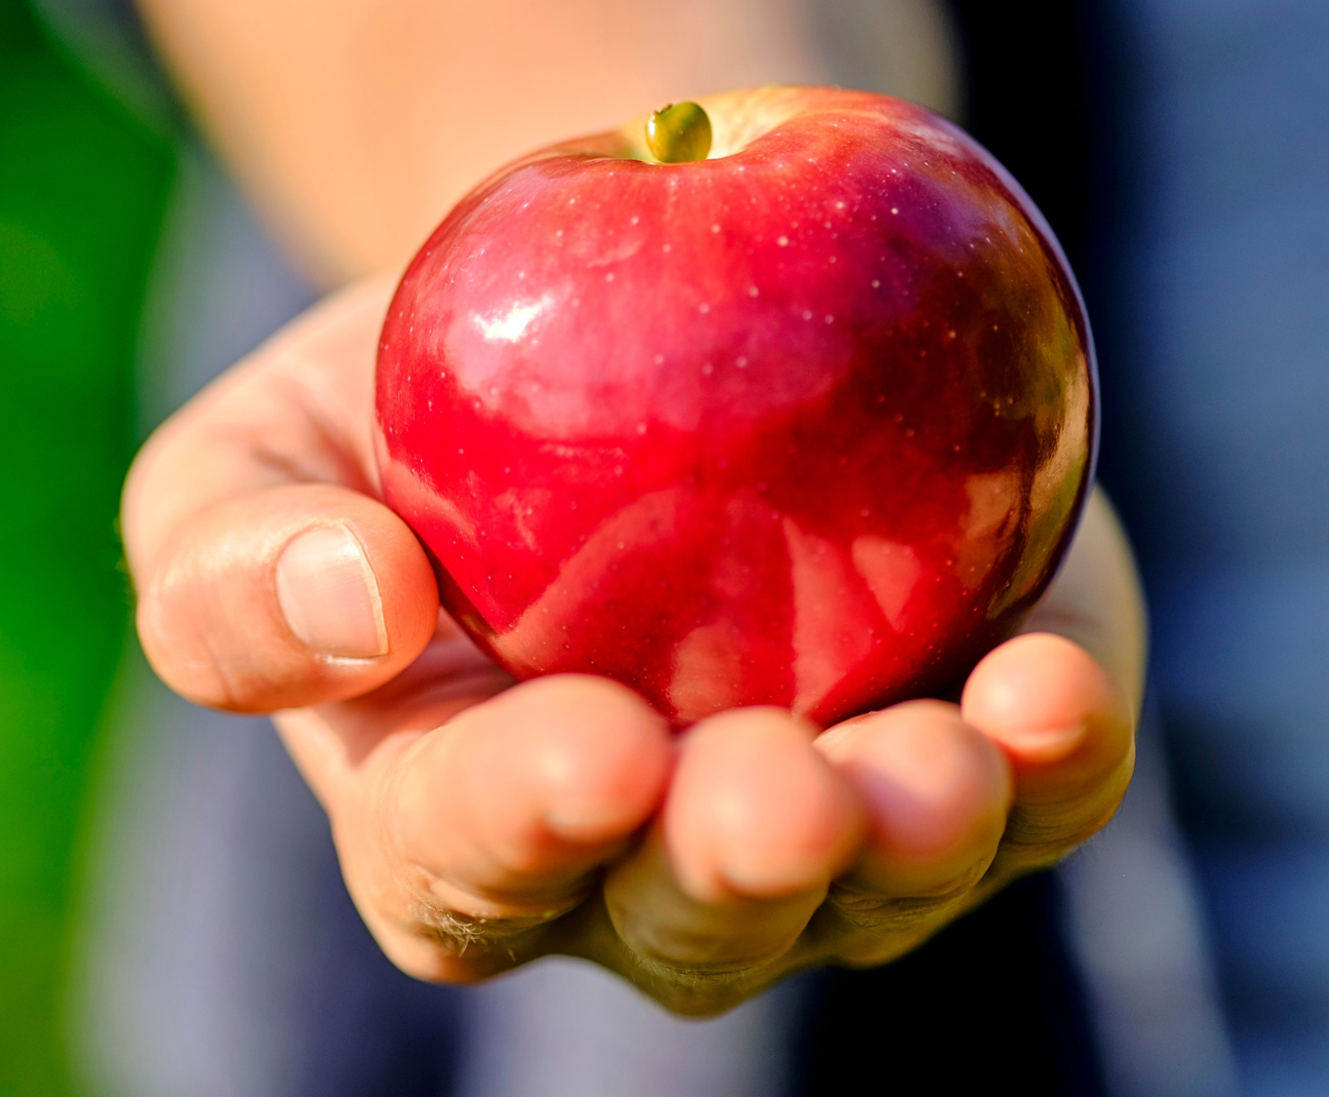
Notes:
He stood up slowly, dusting off his knees, and putting his hand in his pocket he pulled out a single, perfectly ordinary, shiny red apple. Stepping forward he placed it gently on the altar whispering, "Thank you for the sunshine today," his voice like the rustle of autumn leaves. "And thank you for letting my bad knee feel a bit better. This is the best apple from my tree. It’s all yours."
Then shuffling to back and fetching his broom he started to sweep up the sand muttering quietly to himself “a caretaker’s job is never done!”.
Revd Bluster scoffed, his nose wrinkling as if he had smelled an old cabbage. "Preposterous! A total waste of time! No booming melodies! No extra candles! Not a single lyric running on the modern screens! And not a thread of proper minister's vestments on his back! That won't score a single point!"
Looking past Revd Bluster Thomas saw where the little red apple sat glowing in a beam of sunlight. Then he looked back at the kitchen, where Father Timothy, the churchwardens, and the tired volunteers were gratefully cradling warm mugs of tea, sharing stories of kids who had heard about God's love on the sand that week.
(pause)
Thomas understood.
Worship wasn't about the props, the wardrobe, or the technology. It wasn't about how high the incense smoke drifted, how bright the candles burned, how state-of-the-art the modern screens were, or whether you preferred traditional hymns, modern worship music, or elaborate vestments. Worship was simply giving the very best of what you had—whether it was an open heart and a shiny red apple, a fresh vase of lilies just to make the place look nice, a warm cup of tea served with love, a week spent building sandcastles to show a teenager that they matter to God, or a churchwarden tracking down structural cracks to keep the spiritual home standing strong. It was all a gift to the One who made the sunshine.
(Pause and Pick up the shiny red apple, look at it, and then look directly back up at the congregation.)
It’s a silly little story, isn't it? A pompous man in grand robes, flashing screens, a whistling kettle in the back, and an old caretaker offering nothing but a shiny red apple.
But if we are honest with ourselves, we are much more like Revd. Barnaby Bluster than we care to admit.
We easily fall into the trap of thinking that worship is a scoreboard. We think it’s about the quality of our music, the tradition of our incense and candles, the brilliance of our technology, or how flawless we look sitting in our pews on a Sunday morning. We mistake the machinery of church for the heart of God.
And that is exactly what was happening two thousand years ago at a dusty well in Samaria.
You see, the woman Jesus met at that well was doing the exact same thing Revd Bluster was doing. When Jesus began to shine a light on the raw, broken realities of her personal life, she got uncomfortable. So, she did what many of us do: she threw up a religious smokescreen. She started a debate about the rules, the props, and the locations. She looked at Jesus and said, 'Our ancestors worshiped on this mountain, but you Jews say Jerusalem is the only place to do it. Who has the right building? Who has the better performance?'

Slide 10
The Redefinition (John 4:23)
"True worshipers will worship the Father in Spirit and Truth...“
• Spirit: Inward heart devotion, not outward geography.
• Truth: Unfiltered authenticity, not a performative mask.
Notes:
And Jesus looked right through her theological distraction, and responded, redefining worship:
'...The hour is coming when neither on this mountain nor in Jerusalem will you worship the Father... True worshipers will worship the Father in spirit and truth, for the Father is seeking such people to worship him.'
Jesus was telling her that the days of needing a specific building, a specific wardrobe, or an exclusive earthly ritual are officially over.
However, we mustn’t mistake this to mean that worshipping it’s easy. Worship isn’t just some vague, comfortable feeling we carry around. True worship has a cost. Long before Jesus spoke to the woman at the well, another man showed what authentic worship looks like when faced with real danger.

Slide 11
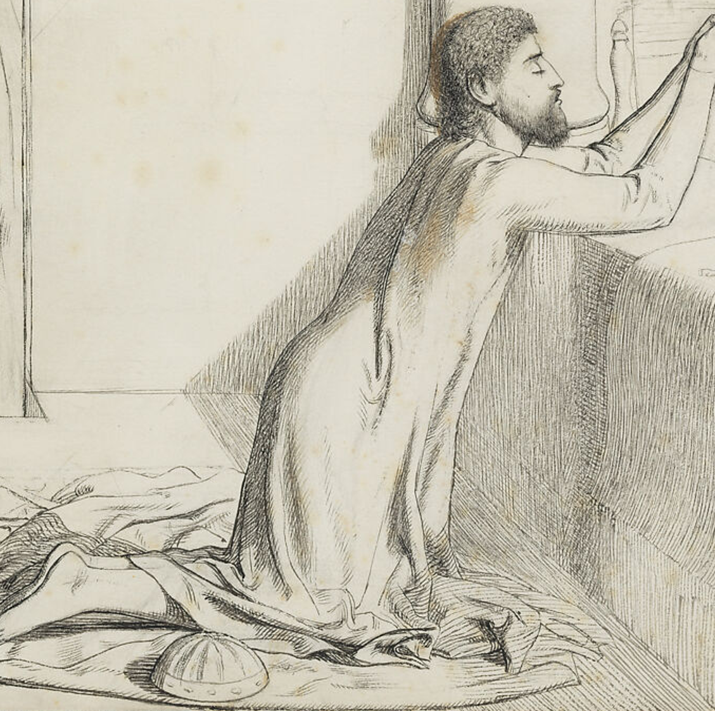
The Cost (Daniel 6:10)
FEARLESS DEVOTION
When the performance is stripped away and danger arrives, true worship refuses to compromise. 🚪🪟
Daniel prayed with his windows open.
Notes:
Daniel was a top official in a pagan empire, and his enemies wanted to destroy him. They couldn’t find any dirt on his character, so they decided to weaponize his relationship with God.
After the king signed the decree, worshipping anyone besides the king became an imperial crime. Daniel responded by going to his upper room opening a window towards Jerusalem, kneeling and giving thanks three times a day as he always had. Daniel did not grandstand or hide in fear; he maintained his daily rhythm of devotion, risking the lions' den simply to offer a heart of thanksgiving.

Slide 12
The Access (Hebrews 10:19-22)
THE VEIL IS TORN
"Confidence to enter the Most Holy Place by the blood of Jesus..."•
No more distance.
• No more fear.
• Draw near with a sincere heart.
Notes:
This fearless devotion finds its fulfilment in Hebrews 10:19–25, which explains how Christ’s sacrifice grants us direct, confident access to the Most Holy Place. Unlike Daniel, who prayed through a window toward a distant temple, believers today can draw near with a sincere heart because the curtain has been torn.

Slide 13
The Community (Hebrews 10:24-25)
Boiling a kettle for visitors 🫖
Arranging flowers to make the space beautiful 💐
Serving behind the scenes to protect the building 🏗️
Building sandcastles on a beach mission 🏖️
Spurring one another on toward love and good deeds.
Notes:
Furthermore, Hebrews calls us to encourage one another and maintain fellowship rather than abandoning community, expressing our worship through mutual support, love, and good deeds.

Slide 14
Question
Is your worship a performance you attend, or a life you surrender?
Notes:
So my question to you and myself is this
Is your worship a performance you attend, or a life you surrender?

Slide 15
To Think About
Where do we see ourselves in Revd Bluster’s “scoreboard” approach to worship?
What practices help us cultivate a “Mr Twigg” kind of personal devotion?
How does our church embody Hebrews 10:19–25 — and where could we grow?
What gifts do we each bring to corporate worship that are not musical or liturgical?
How does personal worship during the week change the way we gather on Sunday?
Notes:
Things to think about in the coming weeks,

Slide 16
Personal worship fuels authenticity.
Corporate worship fuels unity.
Both are essential for a healthy, resilient, Christ-shaped life.
Notes:
Worship is the offering of the heart — privately and together — where personal devotion fuels authenticity, and corporate gathering fuels unity, so that the whole Church becomes a living sacrifice of praise.

